Slide 1
Perfusão para transplantes de fígado
John Hart, MD
Universidade de Chicago, EUA

Slide 2
Declaração de Conflito de Interesse
Dr Hart não ter conflito de interesse a declarar
Em caso afirmativo, especificar: associação financeira relevante
nos últimos 12 meses e que esteja relacionada ao conteúdo da
atividade científica
Exigência da RDC Nº 96/08 da ANVISA

Slide 3
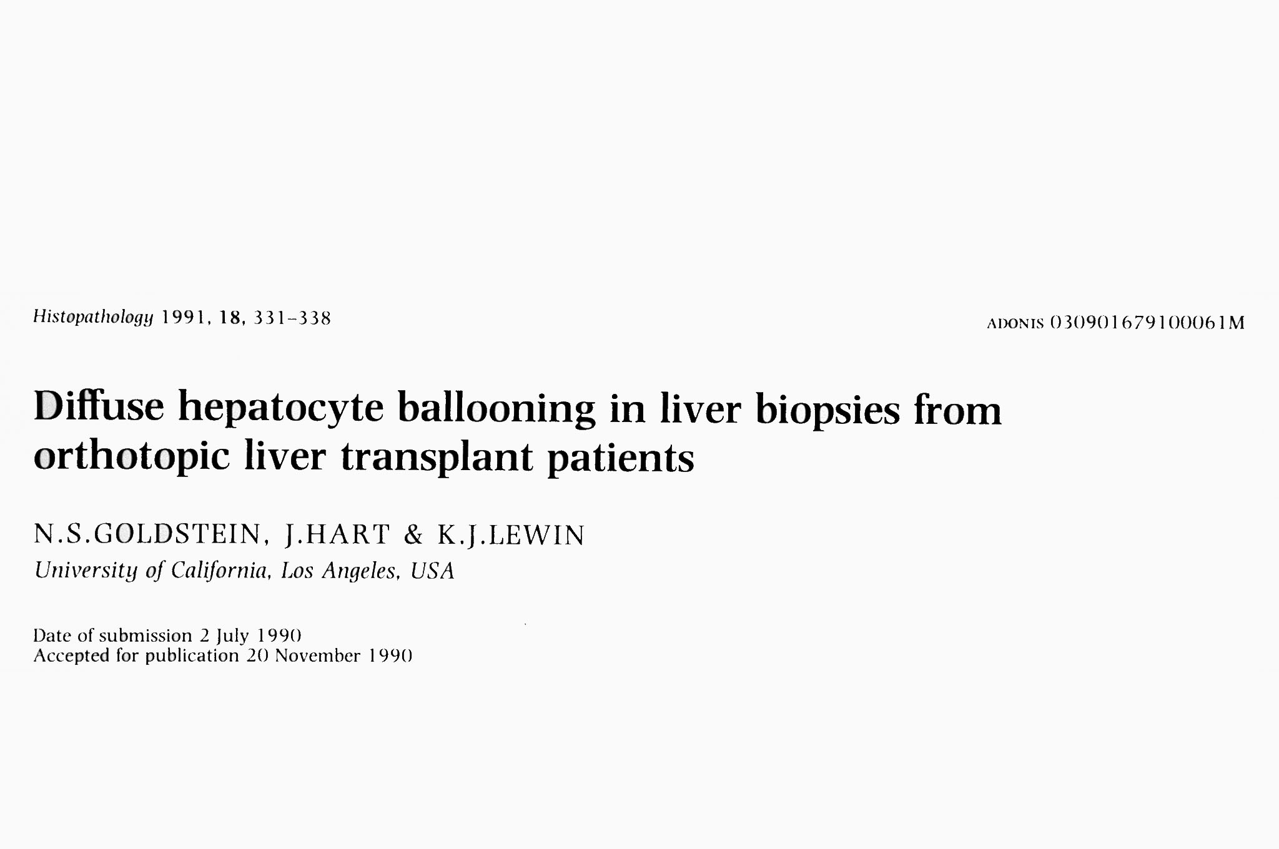
Eight patients with graft dysfunction in the early post-OLT period (7-16 days)
No histologic evidence of acute or chronic rejection
Hepatocyte ballooning - perivenular accentuation
Centrilobular necrosis developed in 6, necessitating re-OLT (n=5) or resulting in death (n=1)
Etiology: PRESERVATION INJURY culminating in PNF

Slide 4
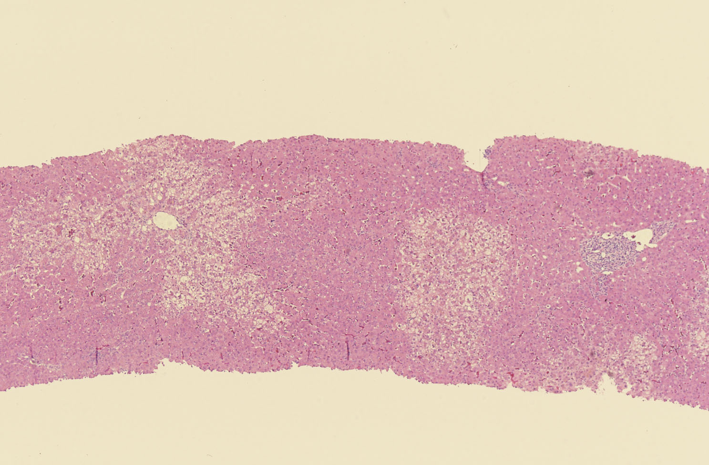
Preservation Injury

Slide 5
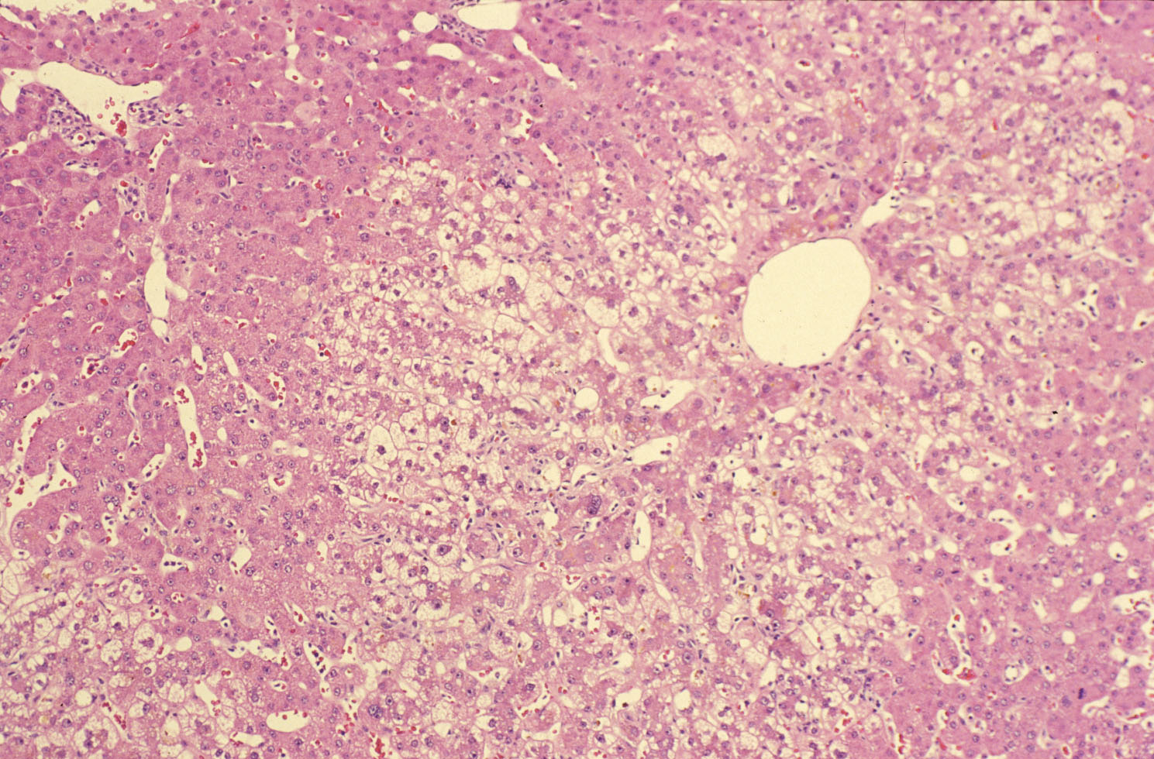

Slide 7
Static Cold Storage (SCS) preservation solutions
EuroCollins solution – 1960s
University of Wisconsin solution (UW) – 1988
Histidine-Tryptophan-Ketoglutarate preservation solution (HTK) – 2005
Lower cost
Lower potassium level
Institut Georges Lopez-1 preservation solution (IGL-1) – 2010
Better for pancreas transplantation
PEG-35 for hydroxyl-ethyl-starch
Chedid MF et al. World J Gastrointest Surg 2019;11(3):122-25. PMID: 31057697

Slide 10
Slide Title

Slide 13
Clinical History
20-9508
20-9766
52 year old M undergoing transplant for decompensated alcoholic cirrhosis
Jaundice, ascites, hepatic encephalopathy (MELD = 36)
Last drink 2 months prior to admission
Paracentesis and variceal banding performed
Portal vein clot with cavernous transformation
Spontaneous bacterial peritonitis
Developed hepatorenal syndrome & pancreatitis/pseudocyst (MELD 41)
Undergoes OLT 14 days after admission to U Chicago

Slide 14
Transplant Procedure (DCD)
Donor was a 56 y.o. ABO matched F who was HCV negative
Liver procured by a surgical team in Nebraska
Routine back table preparation – organ noted to be steatotic
The cold ischemic time was 6 hours
The warm ischemic time was 17 minutes
Re-implantation time approximately 60 minutes
Necrotizing pancreatitis confirmed
No bile production after vascular anastomoses completed
Bi-lobar allograft biopsies procured in the OR

Slide 15
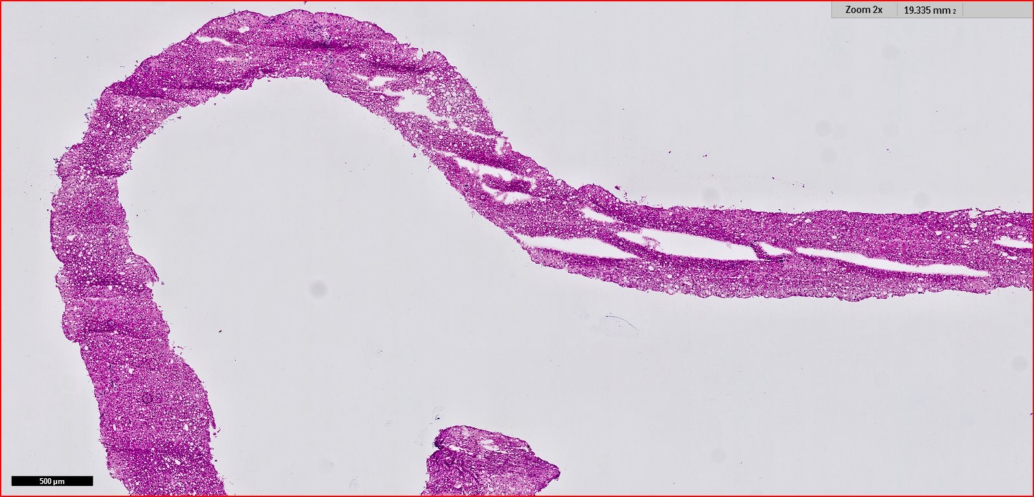

Slide 16
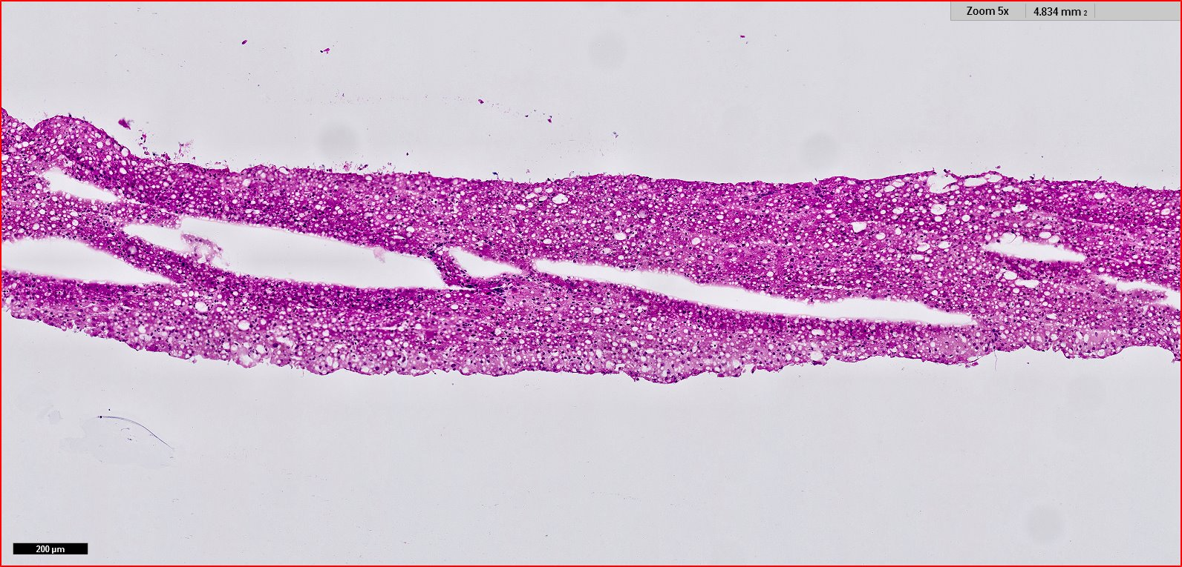

Slide 17
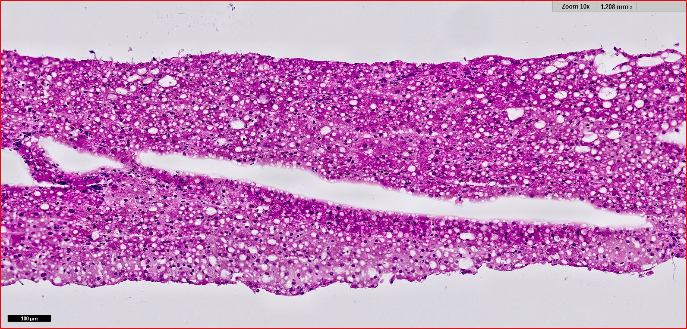

Slide 18
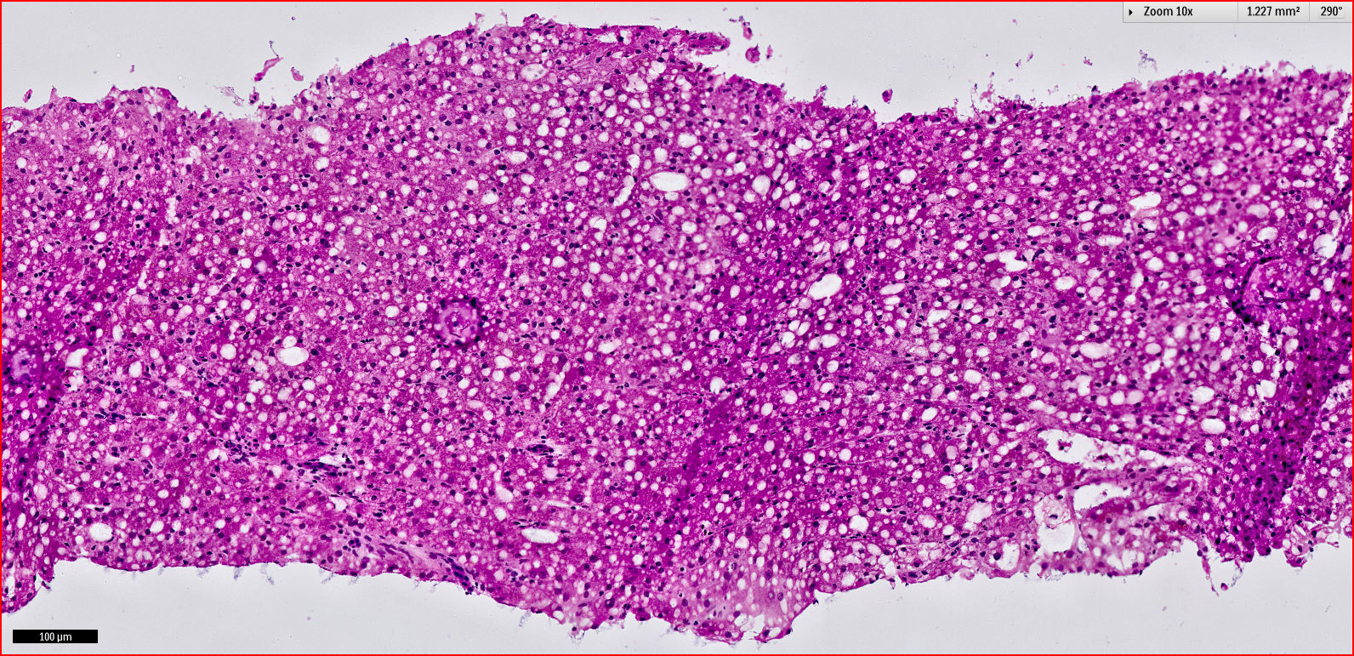

Slide 19
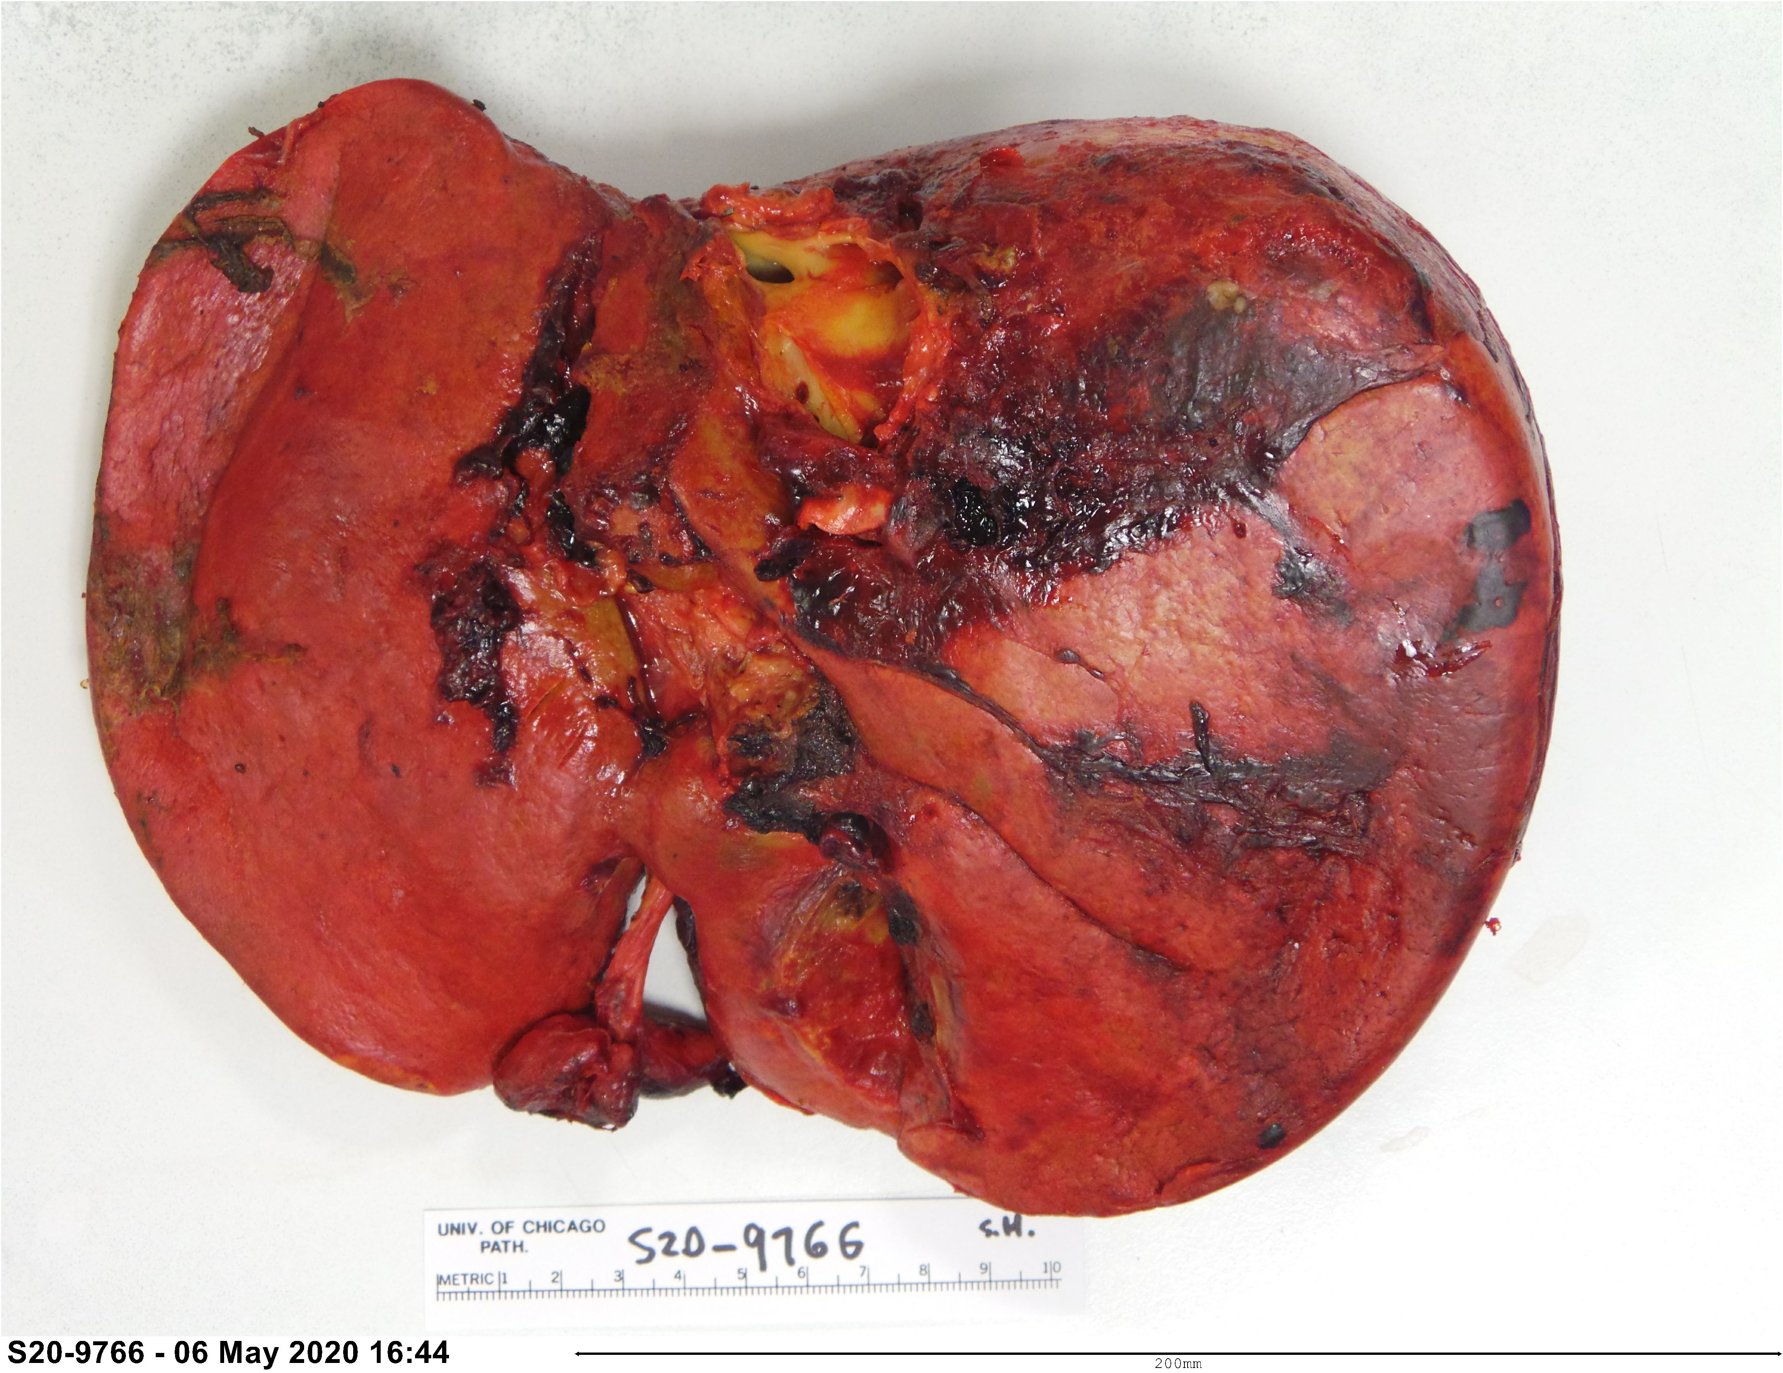
Graft failure on POD #5

Slide 20
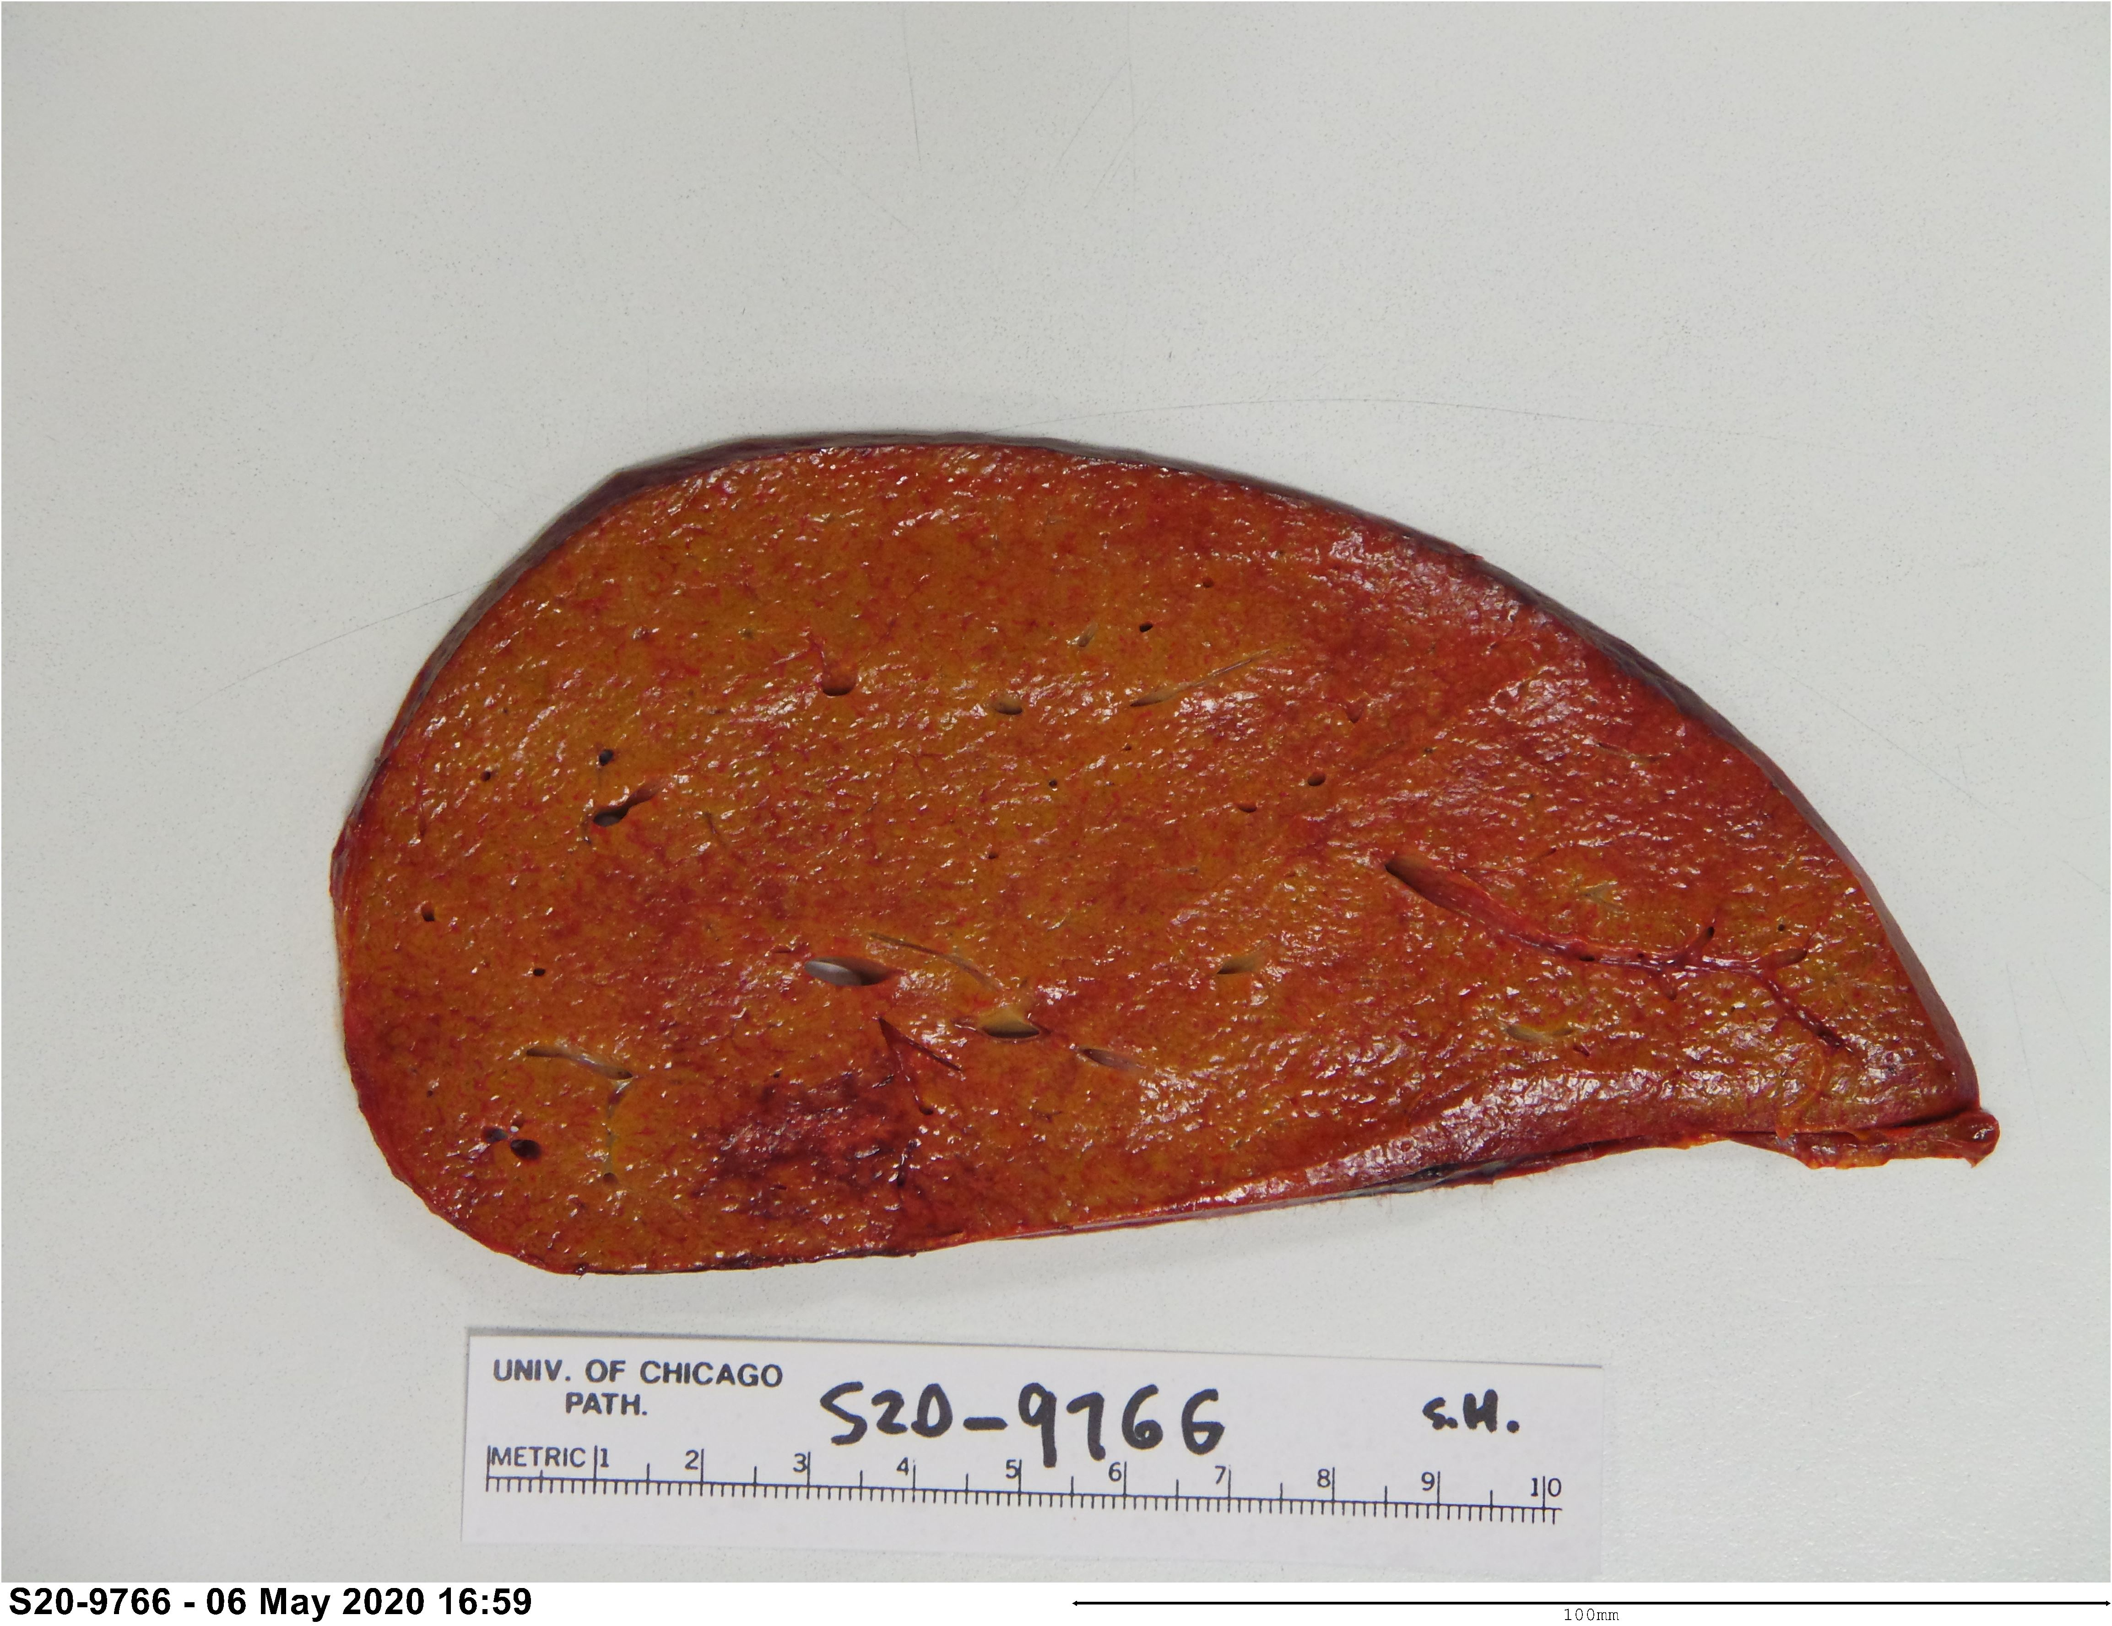
Graft failure on POD #5

Slide 21
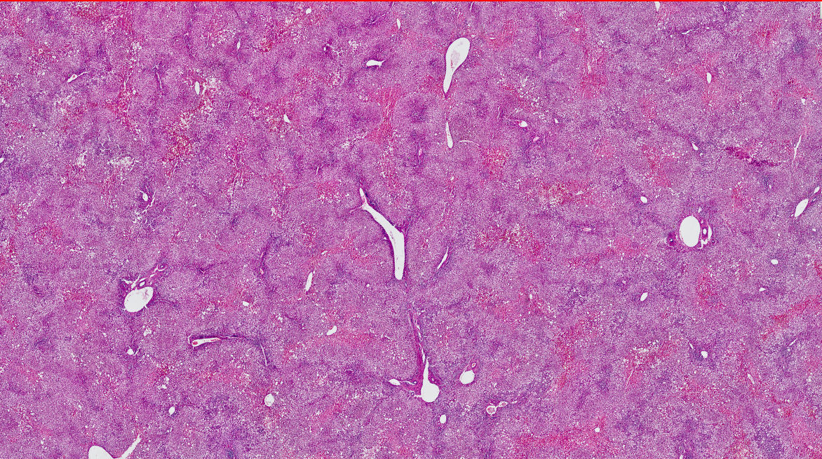

Slide 22
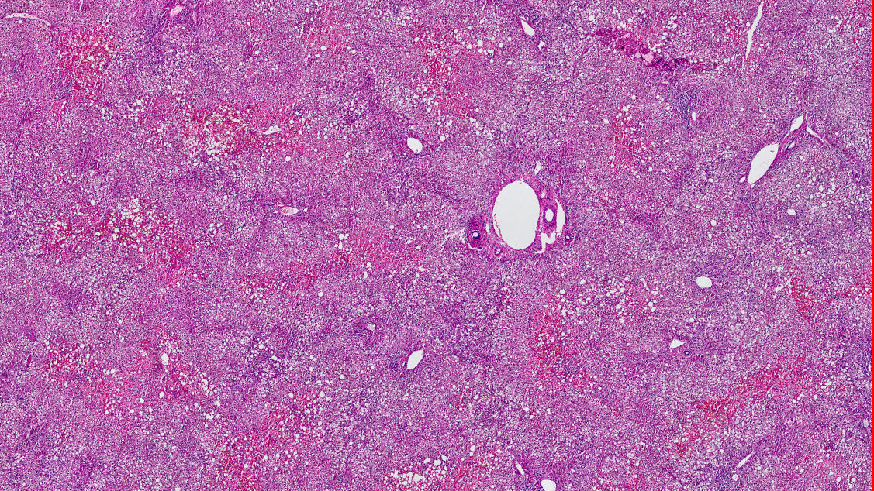

Slide 23
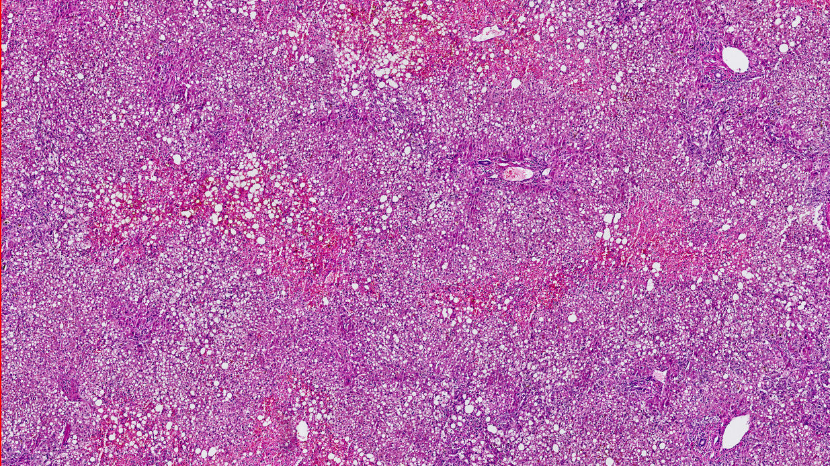

Slide 24
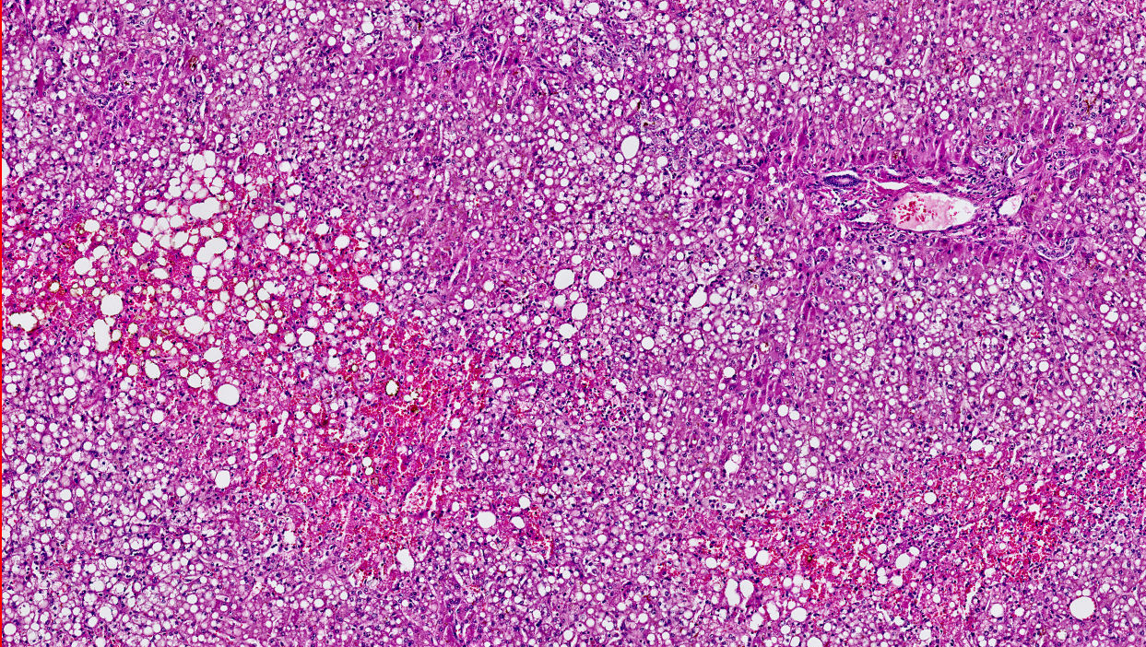

Slide 25
Notes:
RT = re-implantation time

Slide 26
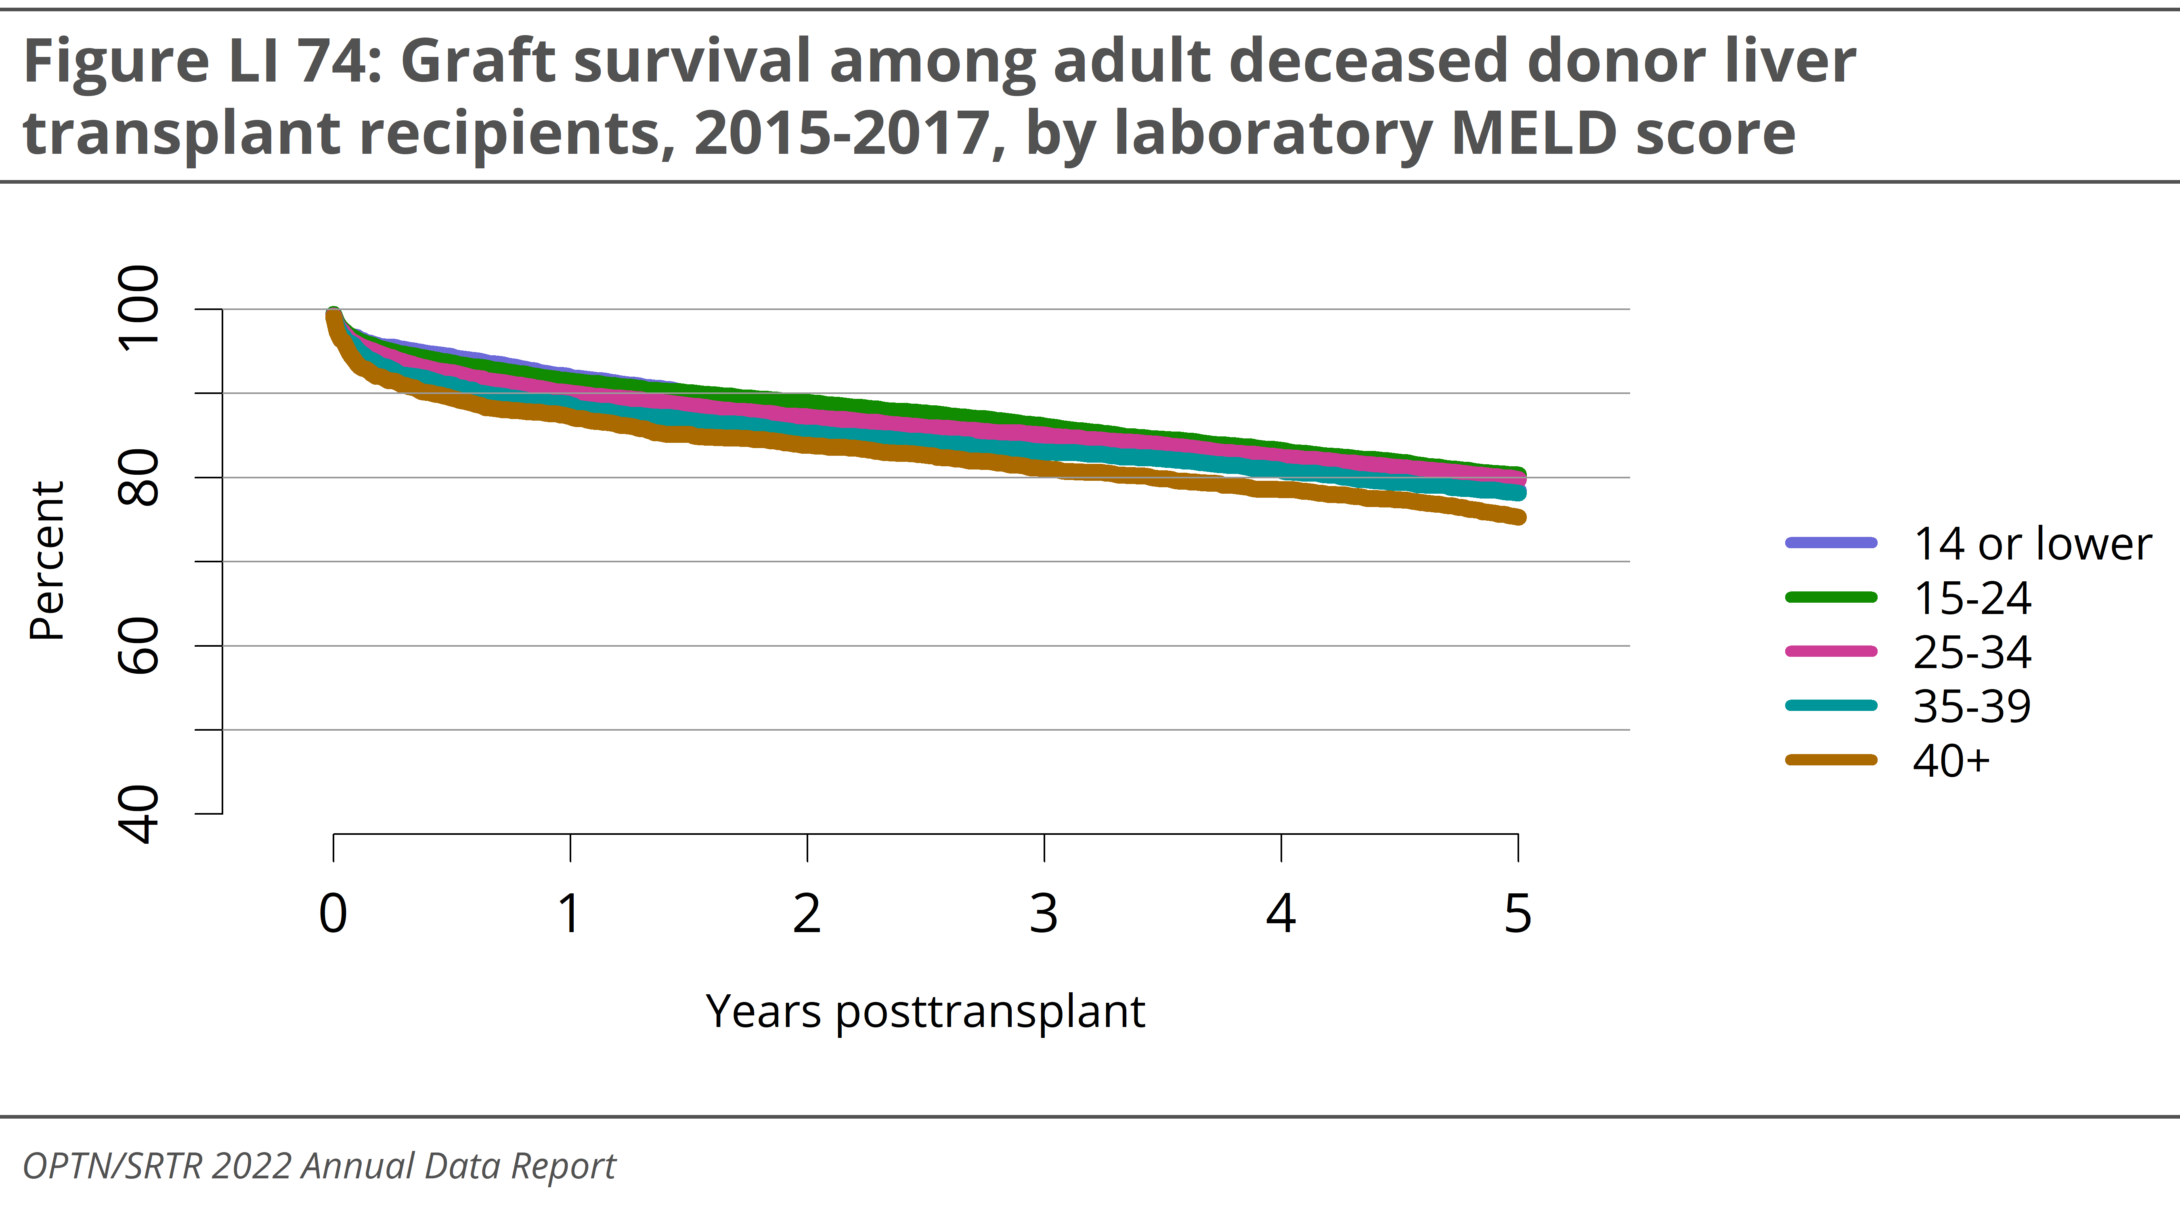

Slide 27
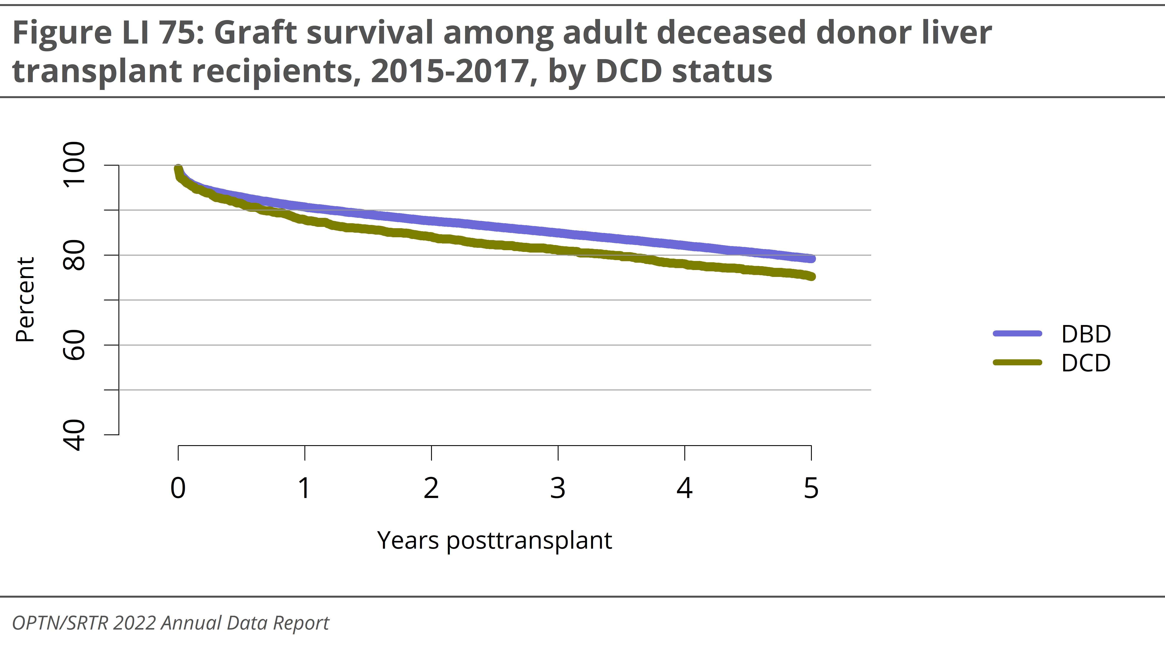

Slide 28

Machine perfusion for donor liver
Advantages:
Extended criteria donors (older donors, steatotic grafts, prolonged cold ischemia time, DCD)
Decreased allograft damage (less ROS generation, less ischemia prefrofusuion injury)
Decreased pro-inflammatory reaction
Viability testing
Disadvantages:
Cost and additional resources
Real world logistical challenges

Slide 29
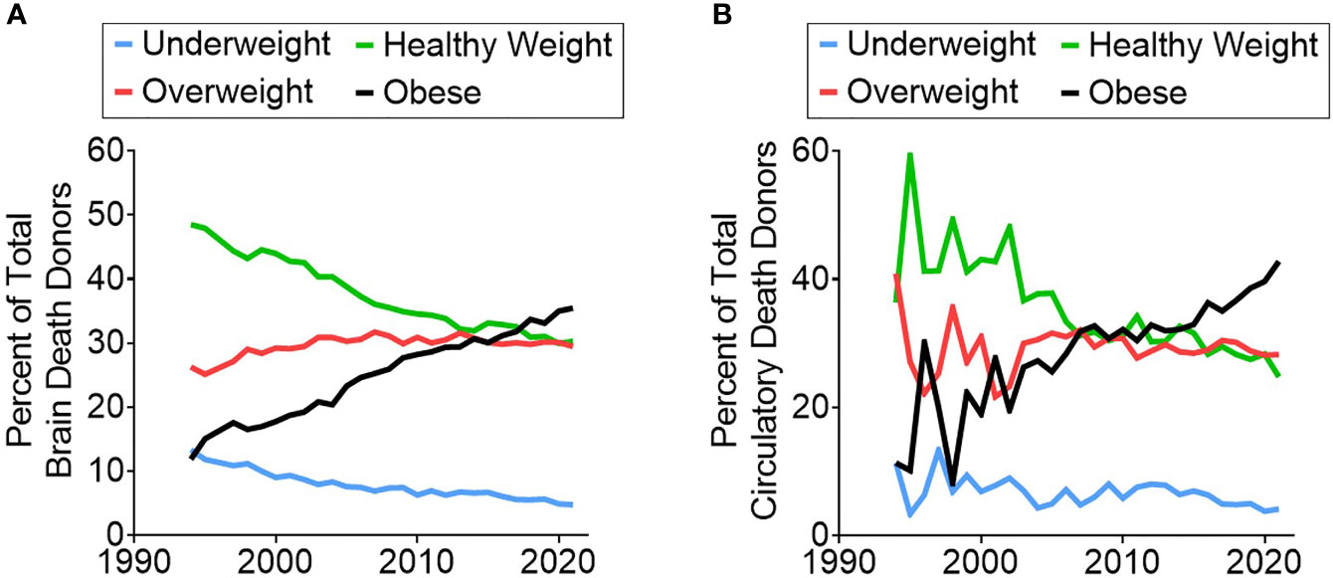

Slide 30
Olthoff KM et al. Validation of a current definition of early allograft dysfunction in liver transplant recipients and analysis of risk factors. Liver Transpl 2010; 16(8):943-9.
Early Allograft Dysfunction:
Serum ALT or ALT > 2000 IU/L
TB > 10 mg/DL
INR > 1.6 on day 7

Slide 40
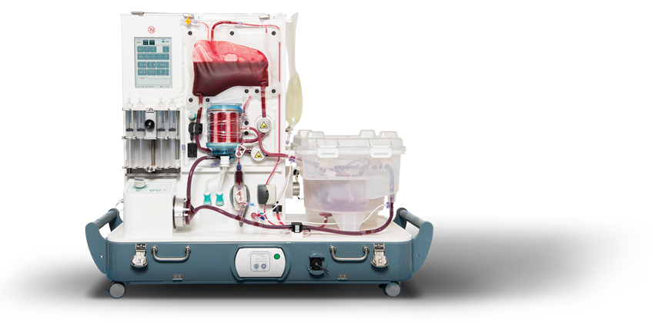
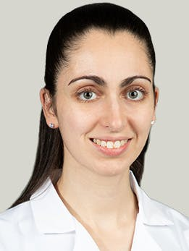
University of Chicago Liver NMP Program
Dr Arielle Cimeno, Transplant Surgery
24 transplants since January 2023
All organs harvested in DCD setting
Function of each graft monitored
Satisfactory function for all donor organs
All grafts performed well – no EAD
Fung JJ, Cimeno A. Invited Commentary: First Things First: Prioritizing Machine Perfusion Goals. J Am Coll Surg 2024; 1;238:853-55.

Slide 46
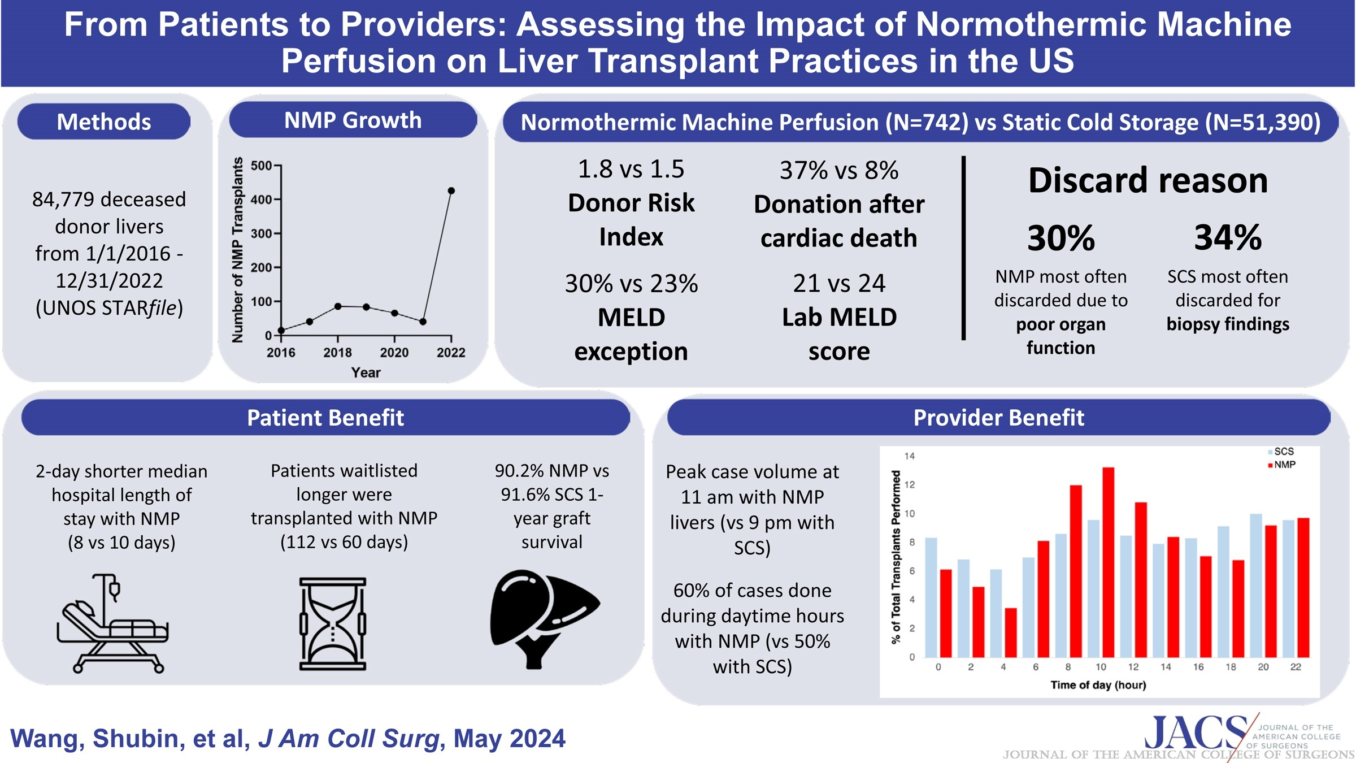

Slide 48
Value of NMP for Liver Transplantation
Assess function of marginal donor organs:
Marked steatosis, DCD, etc.
Decrease discard rate
Improve function of injured donor organs ?
Optimize logistics:
Operating room availability
Extended preservation for combined transplant operations (e.g., heart & liver)
Decrease surgeon burnout

Slide 49
obrigado(A)!

